Slide 1
Mini Capstone Project
Pooja Bhandari

Slide 2
Rental Trends

Slide 3
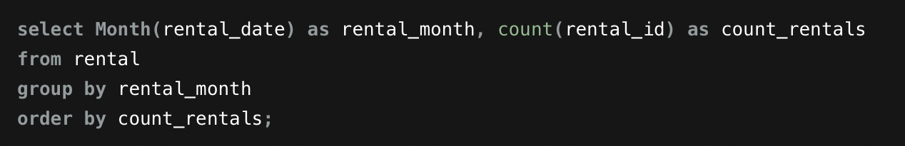
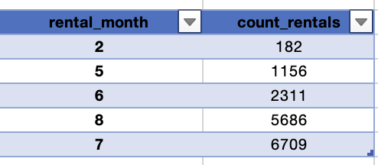
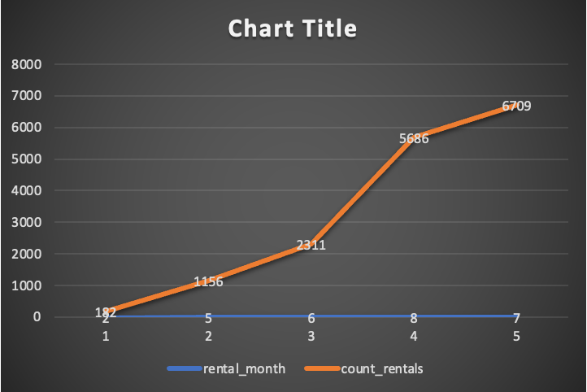
Task 1 : Analyze the monthly rental trends over the available data period.
Observations
Month 2 (February):
Lowest rental count at 182.
Month 5 (May):
Noticeable increase with 1156 rentals.
Month 6 (June):
Significant increase to 2311 rentals.
Month 7 (July):
Peak rental activity with 6709 rentals.
Month 8 (August):
Slight decline from July but still high at 5686 rentals.
Trends
Increasing Trend: There is a general increasing trend in rentals from February to July.
Peak in July: The highest number of rentals occurs in July.
Slight Decline: There's a small decline in August, but rental activity remains high.

Slide 4
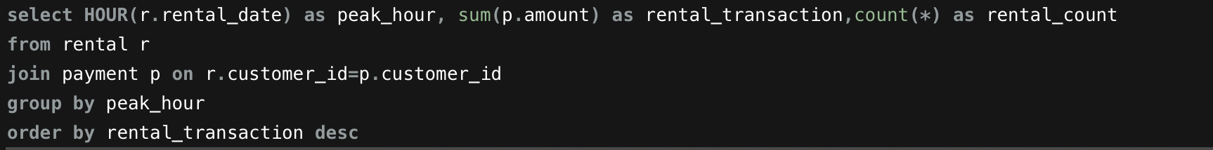
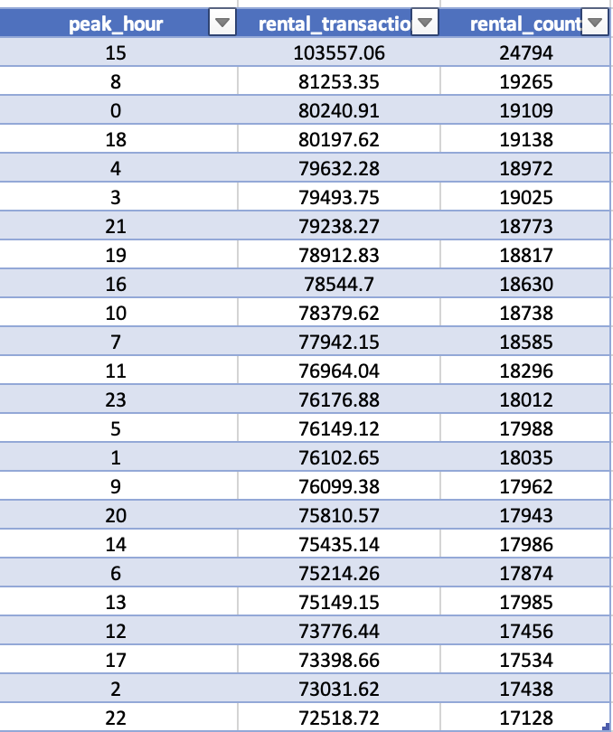
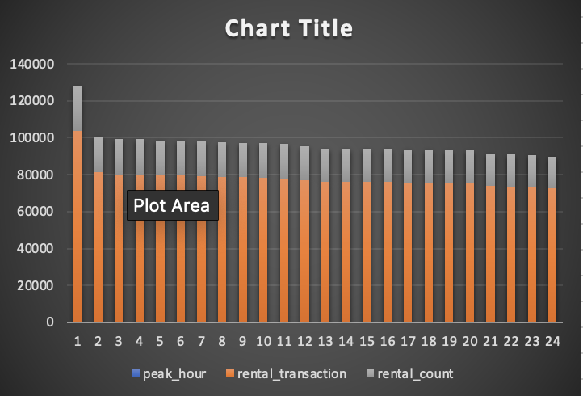
Task 2 : - Determine the peak rental hours in a day based on rental transactions.
Observations
Peak Hour (15): The highest rental transactions occur at 3 PM with a total transaction amount of 103557.06 and 24794 rentals.
Second Peak (8): 8 AM shows the second highest rental transactions with 81253.35 in transactions and 19265 rentals.
Other Hours: Hours 0 (midnight), 18 (6 PM), and 4 (4 AM) also show high rental activities.

Slide 5
Film Popularity

Slide 6
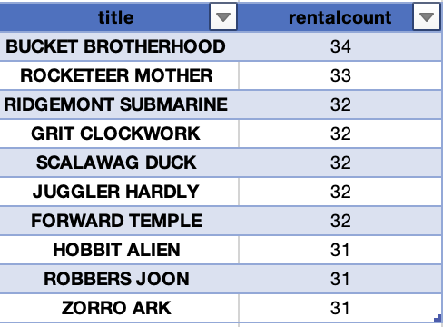
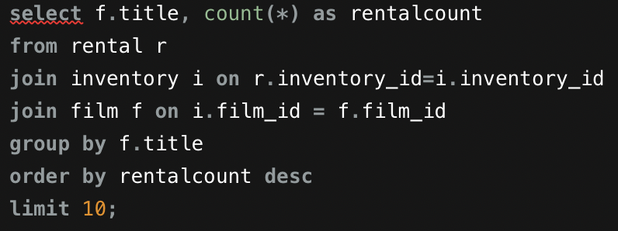
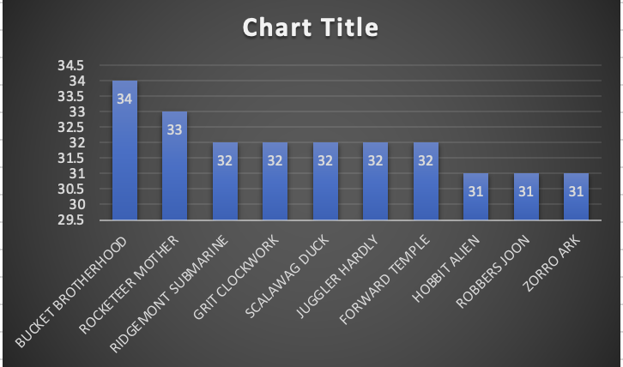
Task 3: - Identify the top 10 most rented films.
Observations:
Most Rented Film:
BUCKET BROTHERHOOD: Topping the list with 34 rentals.
ROCKETEER MOTHER: Second most rented with 33 rentals.
Multiple films share the same rental count of 32, including RIDGEMONT SUBMARINE, GRIT CLOCKWORK, SCALAWAG DUCK, JUGGLER HARDLY, and FORWARD TEMPLE.
HOBBIT ALIEN, ROBBERS JOON, and ZORRO ARK are also popular, each with 31 rentals.

Slide 7
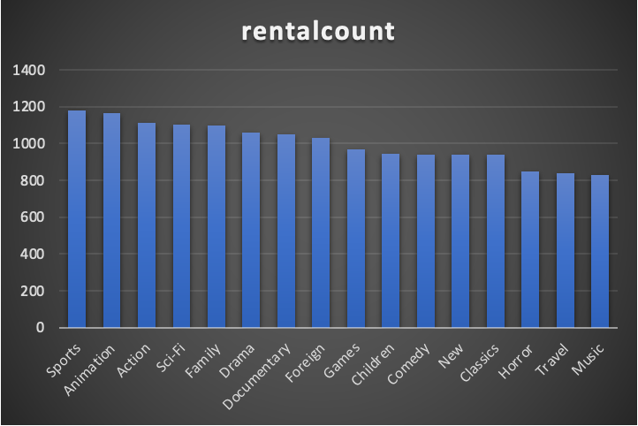
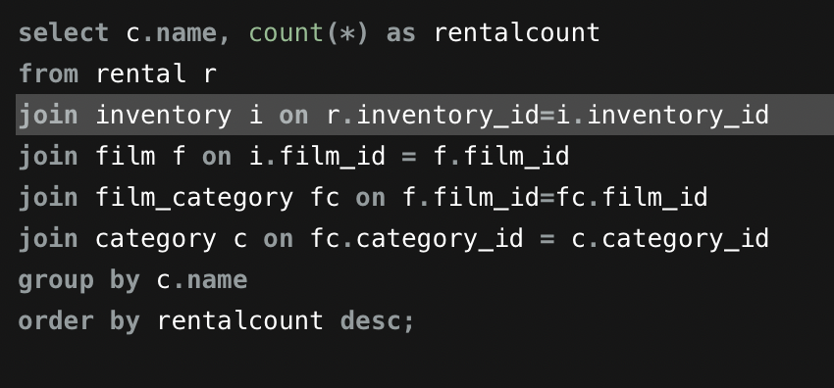
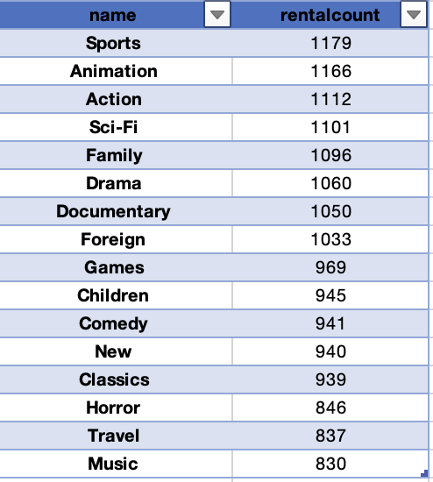
Task 4: - Determine which film categories have the highest number of rentals.
Observations:
Top Categories:
Sports: Leading category with 1179 rentals.
Animation: Close second with 1166 rentals.
Action and Sci-Fi: Also highly popular with 1112 and 1101 rentals respectively
Categories like Documentary, Foreign, Classics, and Horror show a strong interest, although with fewer rentals compared to the top categories.

Slide 8
Store Performance

Slide 9
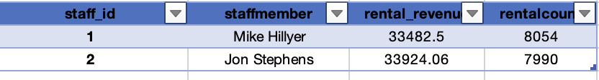
Task 5: - Identify which store generates the highest rental revenue.
Observations:
Top Performing Store:
Store_id 2: This store has the highest rental revenue amounting to 33,924.06 with a total of 7990 rentals.
Task 6: - Identify which store generates the highest rental revenue.
Observations:
Top Performer by Rental Count:
Mike Hillyer: Handles the highest number of rentals with 8054, generating a revenue of 33,482.50.
Top Performer by Rental Revenue:
Jon Stephens: Generates the highest rental revenue with 33,924.06, handling 7990 rentals.

Slide 10
Thank You

